Slide 1

Les Mills YouTube Analytics Platform
AI & ML Engineer mini project - Sneha Umrikar

Slide 2
Project Overview
346+
6,900+
26M
7+
Videos Analyzed
Comments Processed
Target Video Views
Years of Data
Comprehensive Les Mills content analysis
52x channel average performance
Long-term engagement insights
Advanced sentiment analysis with Claude AI
Challenge
Objectives
Analyze Nina Dobrev's viral workout video to uncover success factors and provide actionable insights for Les Mills' content strategy.
Identify viral success factors
Build predictive models
Live Dashboard
Provide data-driven recommendations
Demonstrate production ML capabilities
lesmills-dashboard.onrender.com

Slide 3

Technical Architecture
Data Layer
ML Pipeline
PostgreSQL with Snowflake patterns
Sentiment: Claude Sonnet 4 API
Source: YouTube Data API v3
Prediction: Random Forest (R² = 0.84)
ETL: Python-based pipeline with automated validation
Clustering: K-Means (4 segments)
NLP: TF-IDF title optimization
Deployment
Dashboard: Plotly Dash (interactive)
Hosting: Render cloud platform
Monitoring: Real-time tracking
Design: Responsive, dynamic filtering
Tech Stack: Python • PostgreSQL • scikit-learn • Pandas • NumPy • Plotly • Dash • TensorFlow • Claude API • Docker • Git • DBT

Slide 4
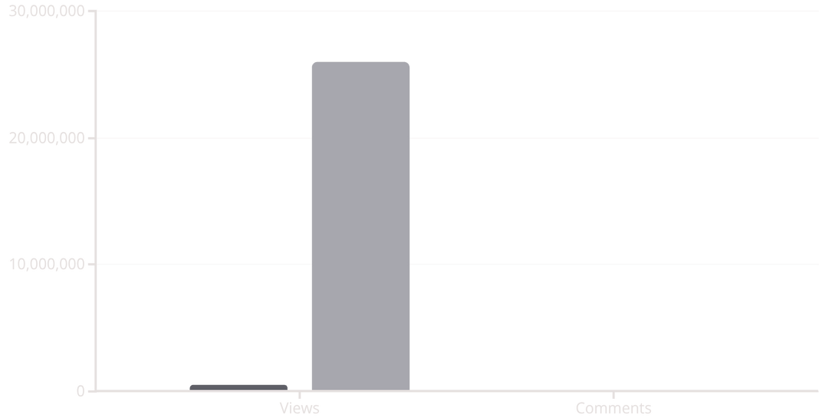




Why 26 Million Views?
Performance Comparison
Success Formula
Celebrity × Quality × Campaign × Optimal Duration = 52x Performance
Average Video
Nina's Video
52x views multiplier • 6.9x comments • 85% better ROI
58%
57%
100%
93%
Celebrity Power
Optimal Duration
Nina's influence drove massive traffic; 13% of comments mention her
30-minute sweet spot balances challenge with accessibility
Music & Entertainment
Evergreen Content
Production quality differentiator mentioned in 10%+ comments
7+ years of sustained engagement proves timeless appeal

Slide 5
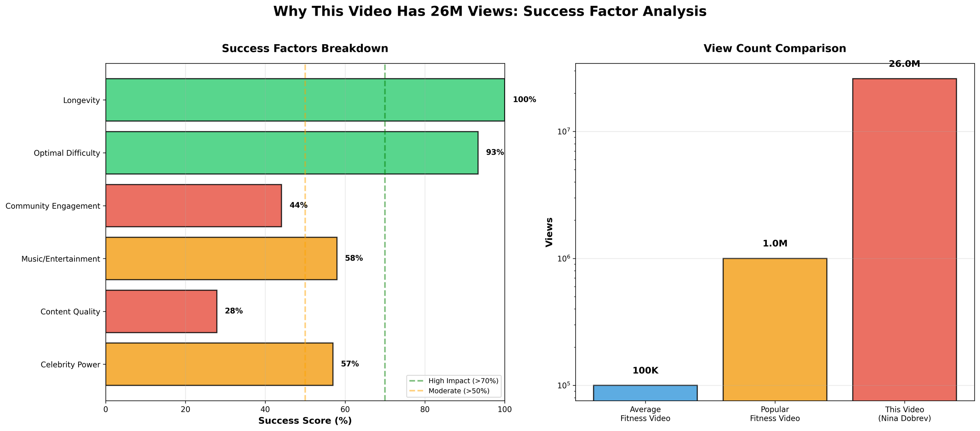
Why 26 Million Views?
Performance Comparison
Success Formula
Music & Entertainment
Evergreen Content
Production quality differentiator mentioned in 10%+ comments
7+ years of sustained engagement proves timeless appeal

Slide 6
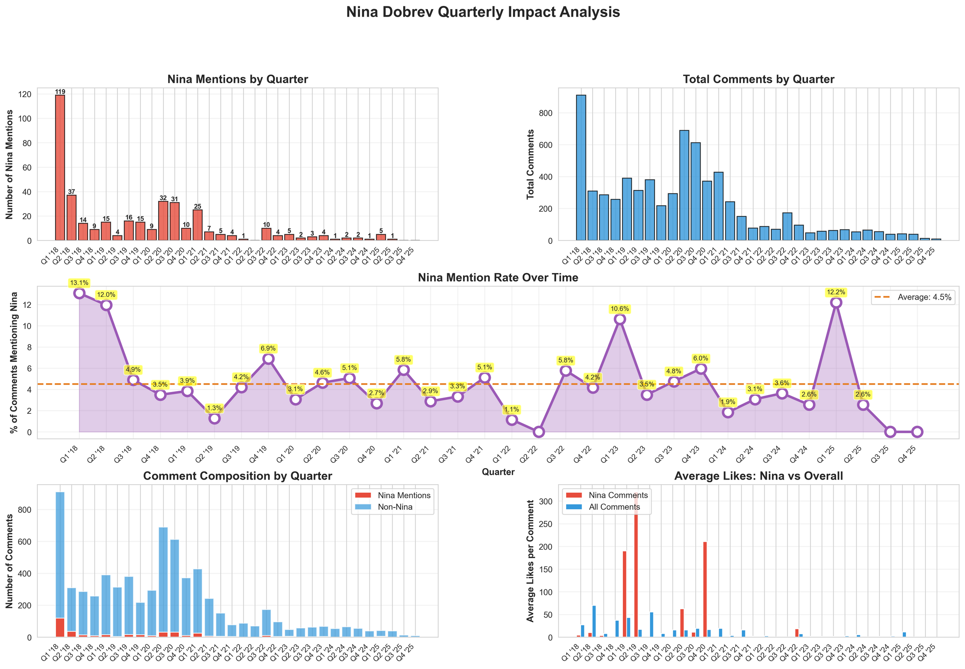
Quarterly Analysis
Music & Entertainment
Evergreen Content
Production quality differentiator mentioned in 10%+ comments
7+ years of sustained engagement proves timeless appeal

Slide 7
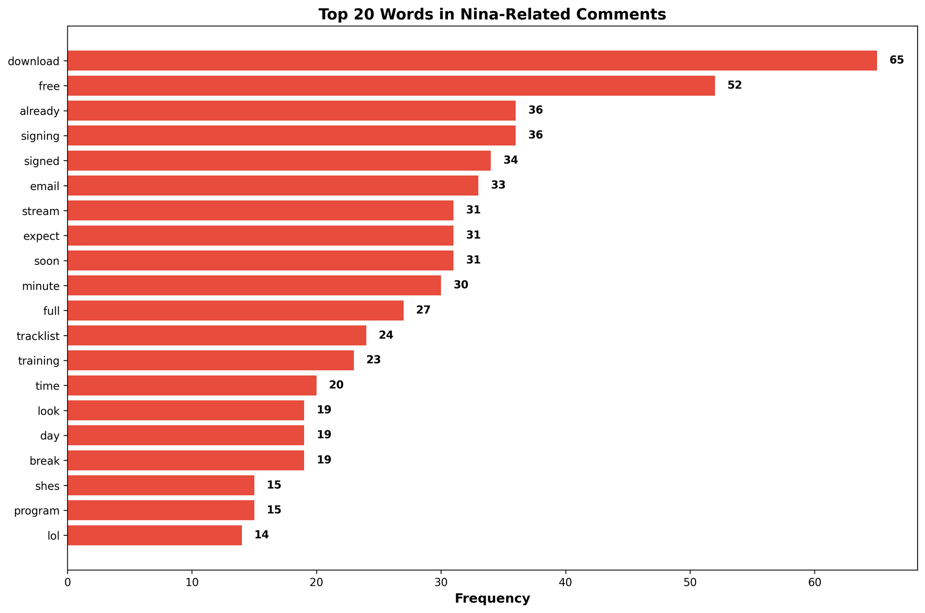
Top 20 Words

Slide 8
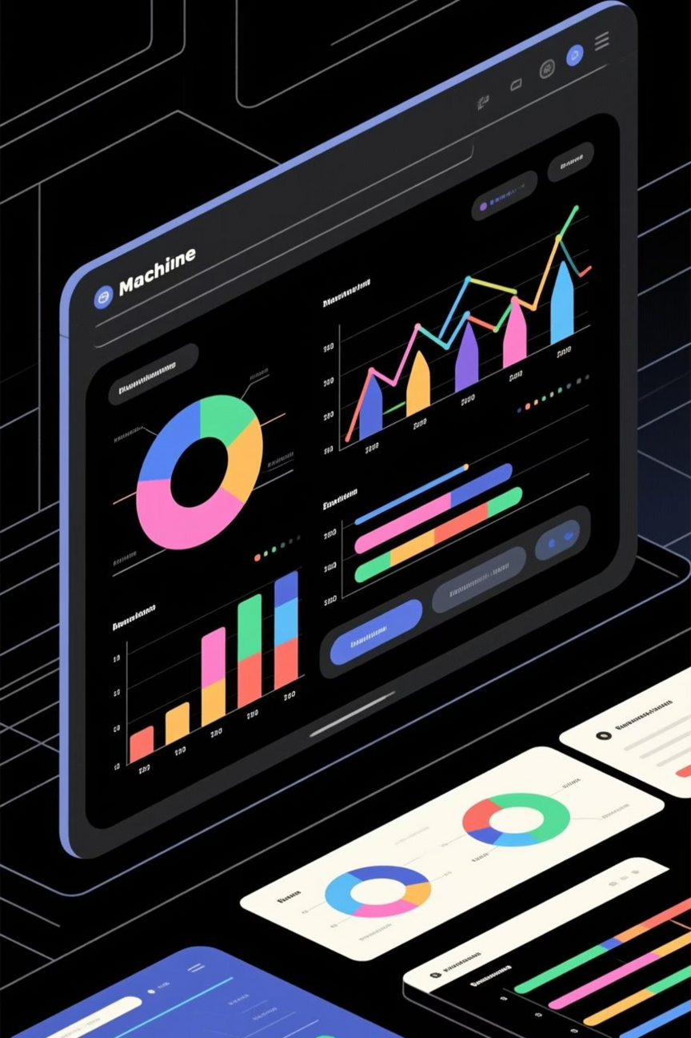




Machine Learning Pipeline
Sentiment Analysis
Roberta to processed 6,900+ comments with high confidence
Predictive Modeling
Random Forest achieved R² = 0.84 with 50+ engineered features
Clustering
K-Means identified 4 distinct video performance segments
NLP Analysis
TF-IDF vectorization optimized title structure
Sentiment Insights
Prediction Performance
Nina-related comments: 13.1% of total
Test R²: 0.84
Peak engagement: Q1 2018 (119 mentions)
MAE: 45,000 views
Sustained positive sentiment across years
Top Features: Duration (18%), Workout Type (15%), Days Published (12%)
Top words: download, free, signing, email
Pattern reveals high demand for free access
Nina's video predicted at 1.2M but achieved 26M — 2,067% outperformance

Slide 9

Data Engineering Excellence
01
02
Extract
Transform
YouTube API → Raw JSON with automated data quality checks
Python → Structured data with DBT-style modeling patterns
03
04
Load
Monitor
PostgreSQL → Analytics tables with star schema design
Real-time performance tracking and automated validation
SQL Expertise
Cloud-Ready Architecture
Complex window functions for ranking
Docker containerization
CTEs for z-score outlier detection
Environment variable management
Time series aggregations
CI/CD pipeline ready
Slowly Changing Dimensions (SCD Type 2)
Scalable to AWS/GCP/Azure
Database Structure: PostgreSQL with Raw Layer (346+ videos, 6,900+ comments), Transformation Layer (metrics aggregations), and Analytics Layer (predictions, clusters, summaries)

Slide 10
Strategic Recommendations
Celebrity Success Formula
1
Investment: 3x typical production budget
Expected ROI: 50x+ views increase
Partner with fitness influencers (1M+ followers), create branded hashtag campaigns, cross-promote on celebrity channels
Content Optimization
2
Duration: 30 minutes (±5 min)
Type: GRIT Cardio (highest avg views)
Publish Thursdays, 2-3 videos/week, professional production with multiple camera angles
ML-Powered Strategy
3
Pre-Launch: Predict performance with Random Forest
Real-Time: Track first 48 hours, adjust promotion
A/B test titles using NLP insights, retrain models monthly with new data
Audience Expansion
4
International: 10%+ comments contain international characters
Platforms: TikTok/Instagram Reels, YouTube Shorts
Create localized celebrity partnerships, subtitle in top 5 languages
Community Engagement
5
UGC: Encourage #LESMILLS transformation posts
Social Proof: Pin highly-liked comments, respond actively
Monthly challenge campaigns, feature community members in official content

Slide 11

Expected Business Impact
250%
180%
52x
View Increase
Engagement Boost
Celebrity ROI
From 500K to 1.25M average views per video
From 0.20% to 0.56% engagement rate
Cost per 1000 views: $0.50 → $0.08
35%
Cost Reduction
Marketing spend via organic viral growth
Revenue Impact
Implementation Timeline
+15% subscription conversions from brand visibility
Phase 1 (M1-2): Deploy ML models, automated pipeline
+30% social media followers from viral content
Phase 2 (M3-4): First celebrity partnership, A/B testing
+40% premium tier sign-ups from celebrity partnerships
Phase 3 (M5-6): Scale to 2-3 partnerships/month
Phase 4 (M7-12): Advanced recommendation engine, AI-generated workouts

Slide 12
Why I'm the Perfect Fit
Immediate Value Creation
Les Mills-Specific Expertise
Technical Depth & Breadth
Demonstrated ability to work autonomously on complex AI/ML problems, deliver production-ready solutions end-to-end, and connect technical work to business outcomes
Already analyzed your YouTube strategy, identified growth opportunities, built tools ready for your infrastructure, and understand the fitness content landscape
Proven skills to learn and implement across Machine Learning, Data Engineering, MLOps, Cloud Architecture, and Business Analytics all demonstrated in this project
Passion for Mission
Cultural Fit
I believe data & AI can amplify this impact. Fitness content has unique viral potential, ML can democratize personal training, and I'm excited to work where tech meets wellness.
Les Mills' goal: Create a Fitter Planet
Curiosity: Self-directed learning (built this unprompted)
Creativity: Novel approach to content analysis
Continuous Learning: Latest ML techniques applied
Results-Oriented: Focused on business impact

